Slide 1

The Impact of Tree Cover on the Urban Heat Islands Effect
Christopher Prendergast, 12/14/2023

Slide 2

Project Description
Explore urban heat island effect (UHI)
Analyze spatial relationship between percent tree cover and temperature
Study area is the City of San Jose, California
Null hypothesis: The observed pattern of temperatures could have occurred through random chance and is unrelated to the distribution of tree cover across the study area

Slide 3

Analysis Steps
Prepare raster datasets
Prepare the study area polygon
Wrangle the point data
Look for spatial autocorrelation
Optimized hotspot, and outlier analyses
Hotspot (Getis-Ord Gi*) analyses
Cluster and outlier (Anselin Local Moran’s I) analyses
Compare hotspots
Generalized Linear Regression
Geographically Weighted Regression (Didn’t run)

Slide 4
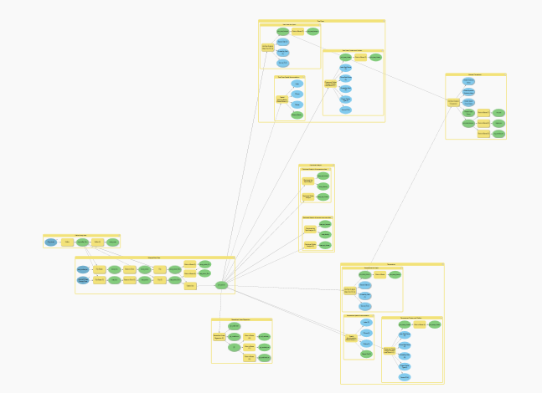
Model Builder -- Overview

Slide 5
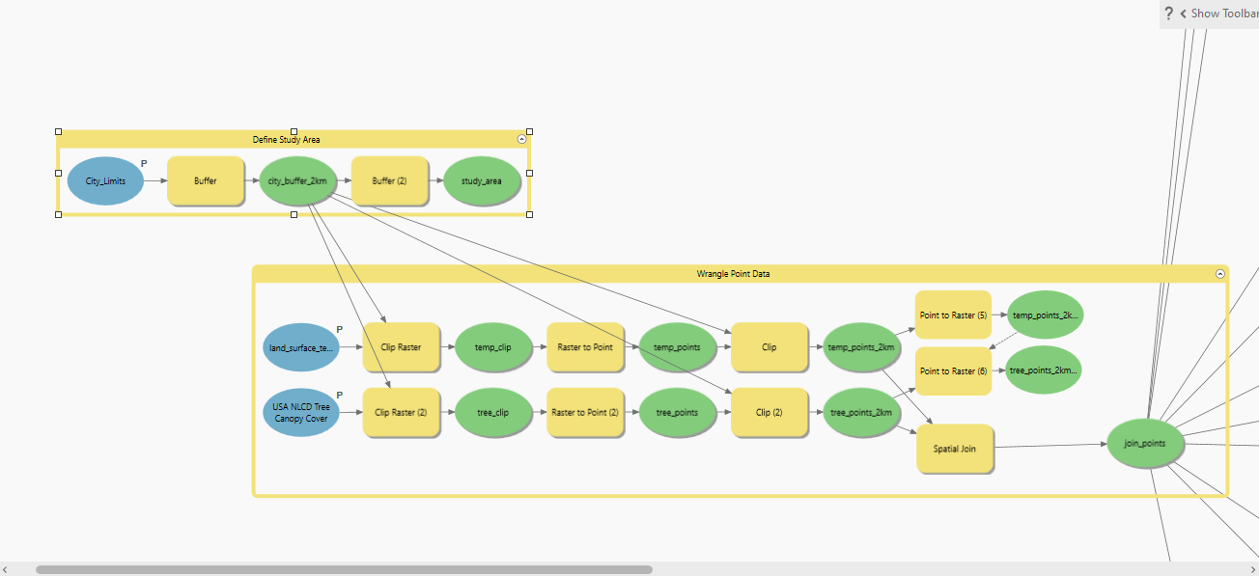
Data Wrangling
Transform the data into the appropriate format for analysis
Convert raster data to points
Create a study are polygon
Clip datasets to the study area
Spatially join the datasets to create a single point feature class for analysis

Slide 6
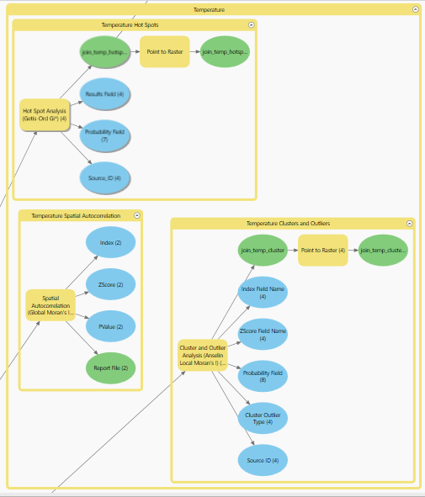
Temperature Analysis
Is the distribution of temperature data clustered, random, or dispersed?
Where are the statistically significant temperature hot spots and cold spots?
Are there any outliers, where are they located?
Convert vector (point) results to raster for display

Slide 7
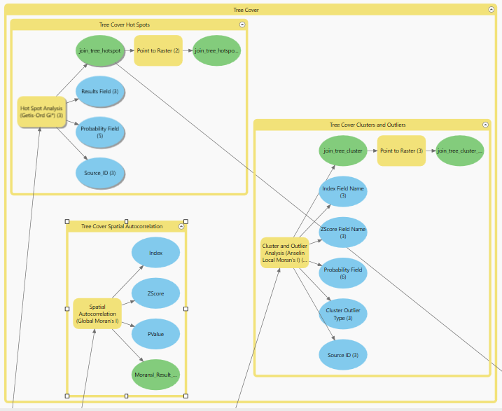
Tree Cover Analysis
Is the distribution of tree cover data clustered, random, or dispersed?
Where are the statistically significant temperature hot spots and cold spots?
Are there any outliers, where are they located?
Convert vector (point) results to raster for display

Slide 8
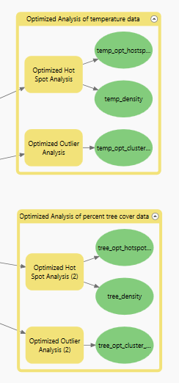
Optimized Hot Spot Analysis
Perform optimized hot spot analysis on both temperature and tree cover datasets
What is the optimum distance to define spatial neighborhoods for analysis?

Slide 9
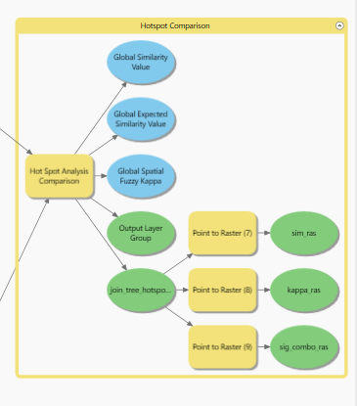
Hot Spot Comparison
How are the statistically significant hot spots in the temperature data related to statistically significant hot spots in the tree cover data?
Where are the areas of agreement and disagreement?
Convert vector (point) results to raster for display

Slide 10
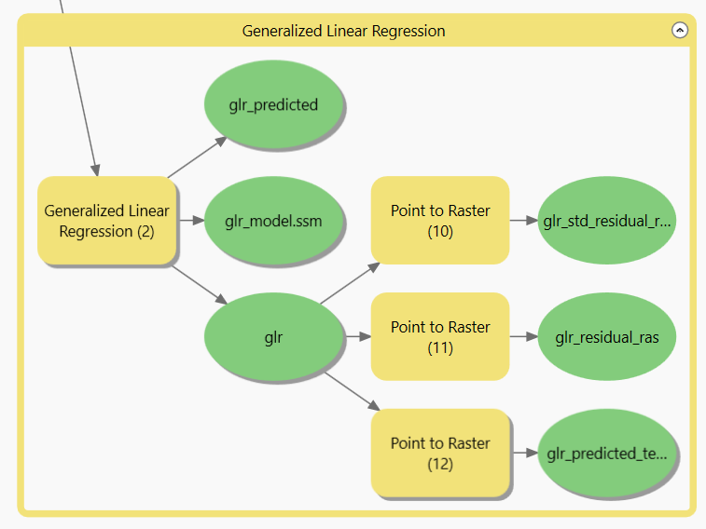
Generalized Linear Regression
What is the relationship between the tree cover and the temperature?
What is the best fit equation to describe this relationship?
How good is this equation at making predictions?
Where does this model work well? Where does it perform poorly?
Convert vector(point) results to raster for display

Slide 11

Interpretation and Evaluation of Results
Percent tree cover and the temperature datasets display:
Statistically significant positive spatial autocorrelation
Statistically significant hot spots and cold spots
Temperature dataset has almost no outliers
Tree cover has relatively few outliers
Hot spot between datasets are correlated
Linear regression shows negative correlation between the percent tree cover and temperature
Hot spot comparison shows strong association between temperature hot spots and tree cover cold spots

Slide 12
Challenges
Rater data does not align so a spatial join is required to prepare the data
Large number of points (>1 million) created from 30 m rasters take a lot of resources to process
Working with large point datasets is problematic for display (solution is to convert back to raster)
Optimized analysis could not find an optimal distance – so, used a distance of 120 m
GLR does not make good predictions for areas of water
It was not possible to run GWR on this dataset (multicollinearity error)

Slide 13
Future Directions
Include additional factors in multivariate linear regression – candidate factors to explore might include elevation, aspect, and land cover type
Rerun analysis with data for additional dates and different seasons
Aggregate data into larger areal units, for example at census block level and rerun the analysis

Slide 14

Results

Slide 15
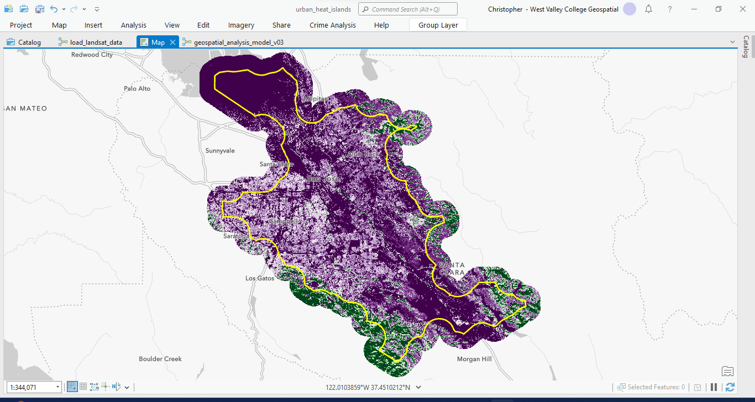
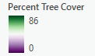
Percent Tree Cover -- Data

Slide 16
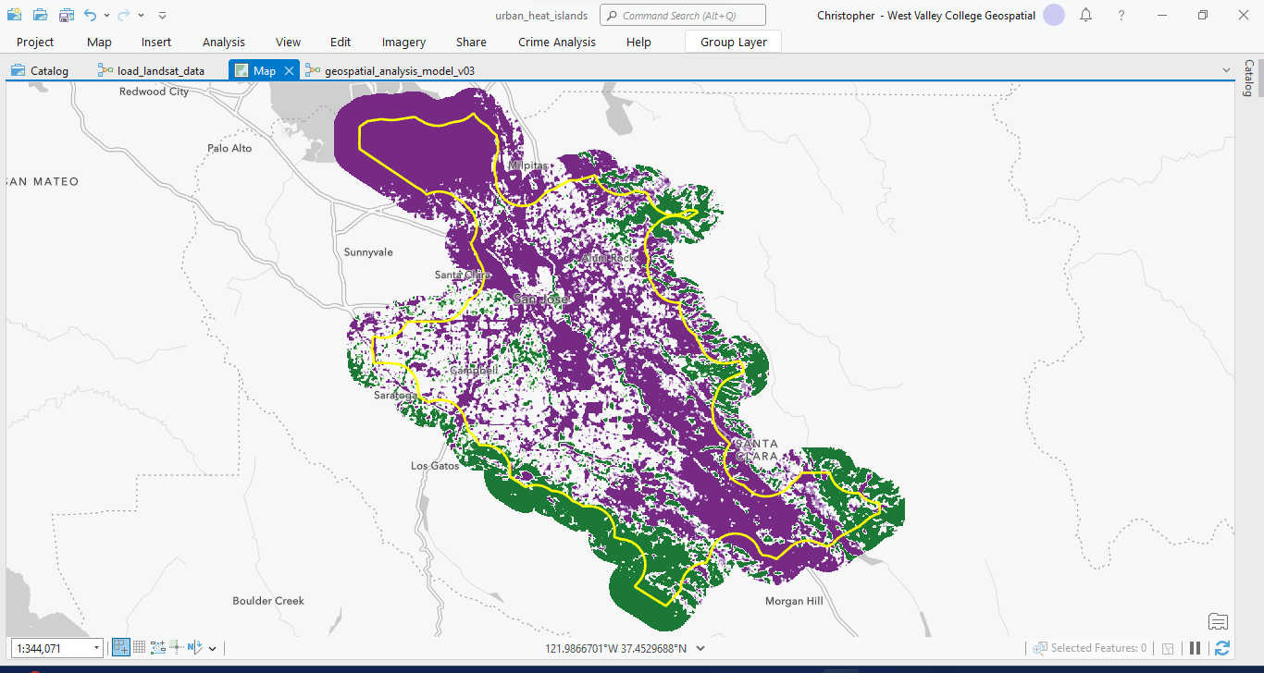
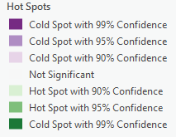
Percent Tree Cover -- Hot Spots

Slide 17
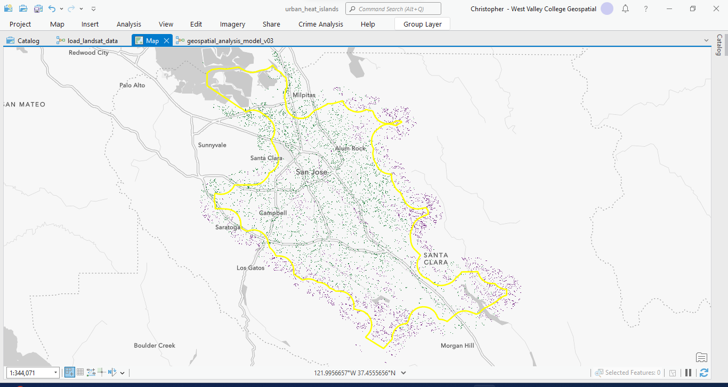
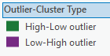
Percent Tree Cover -- Outliers

Slide 18
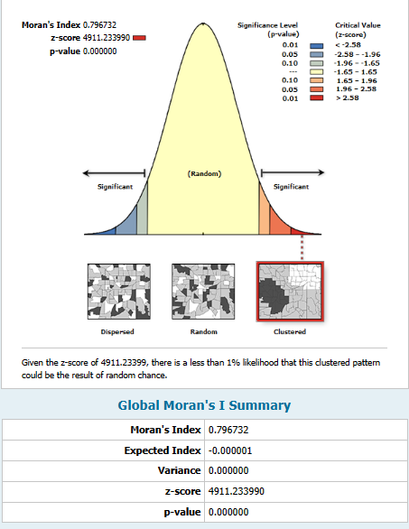
Percent Tree Cover -- Spatial Autocorrelation

Slide 19
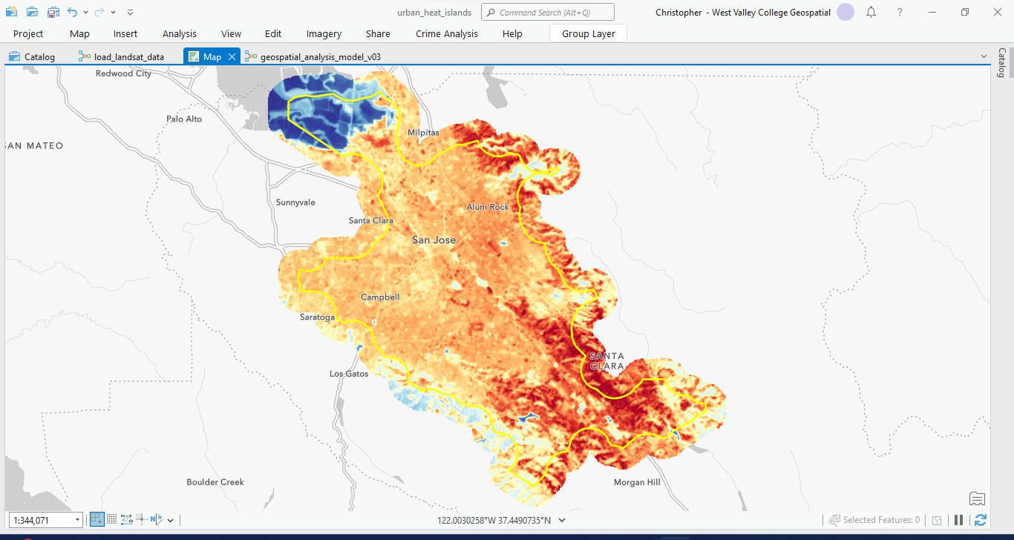
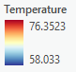
Temperature -- Data

Slide 20
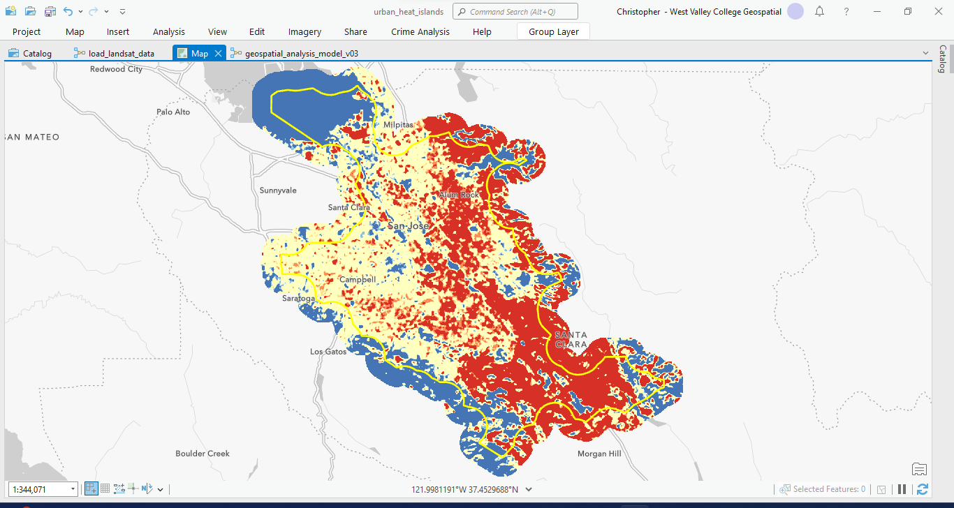
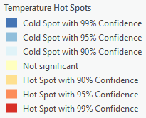
Temperature -- Hot Spots

Slide 21
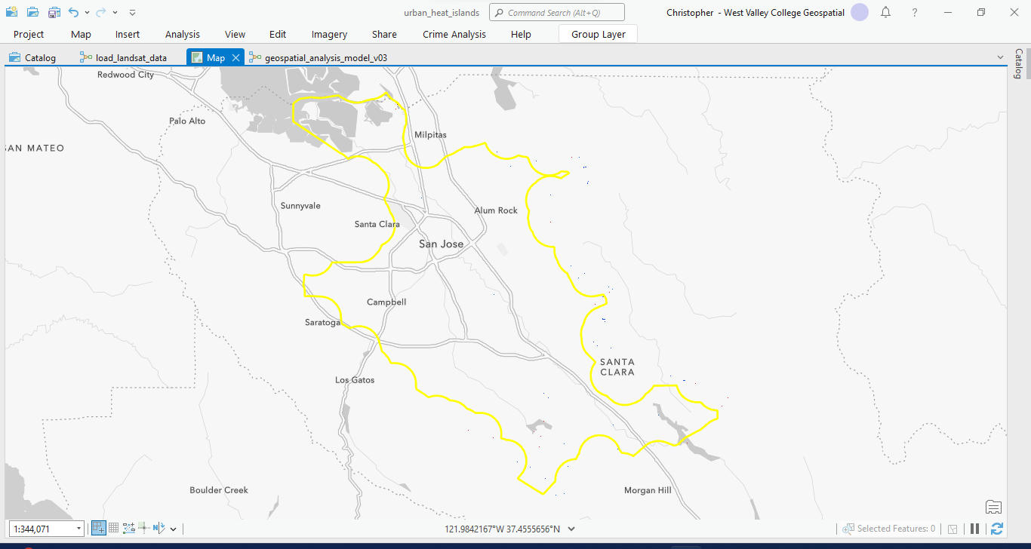
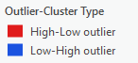
Temperature -- Outliers

Slide 22

Temperature -- Spatial Autocorrelation

Slide 23
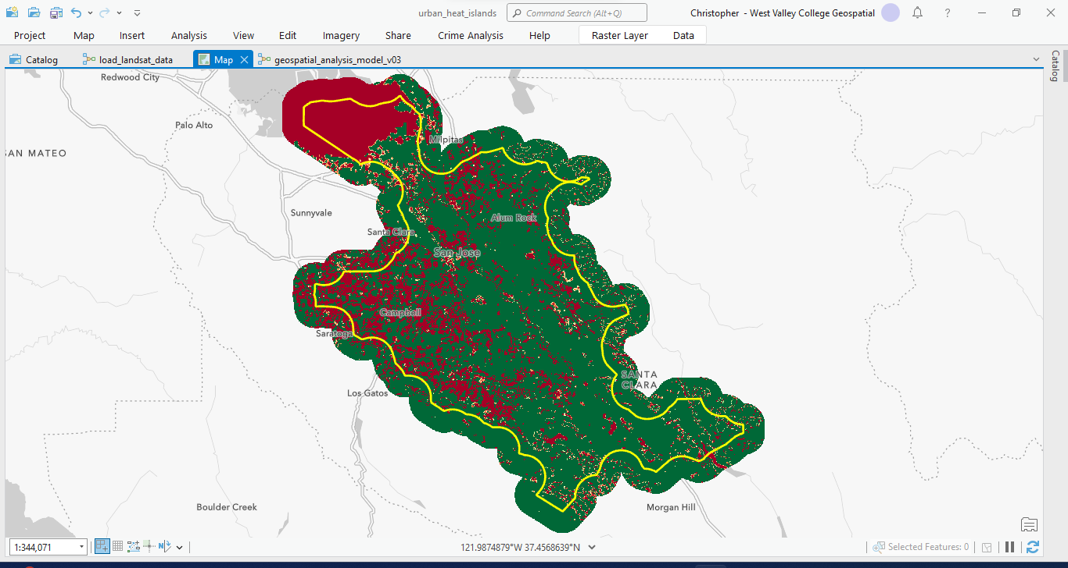
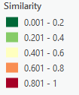
Hot Spot Comparison -- Similarity

Slide 24
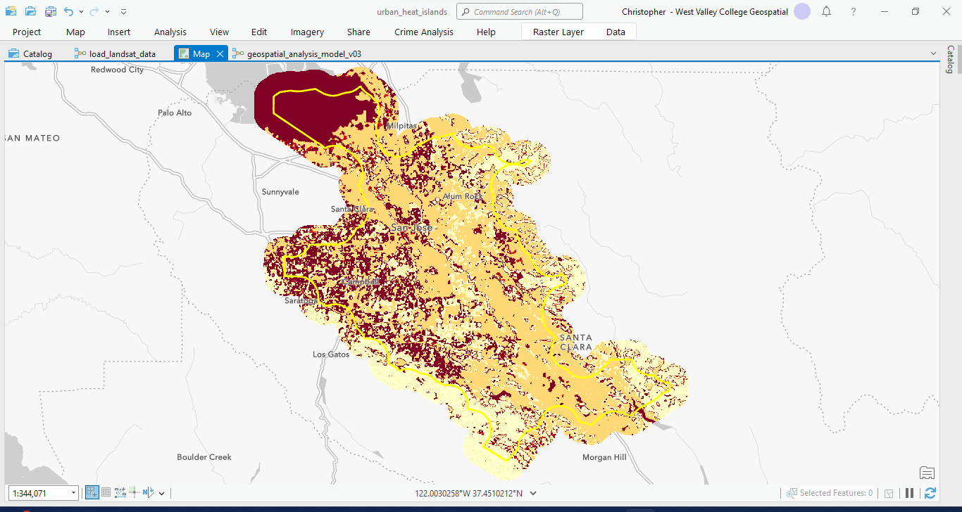
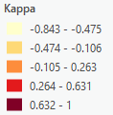
Hot Spot Comparison -- Kappa

Slide 25
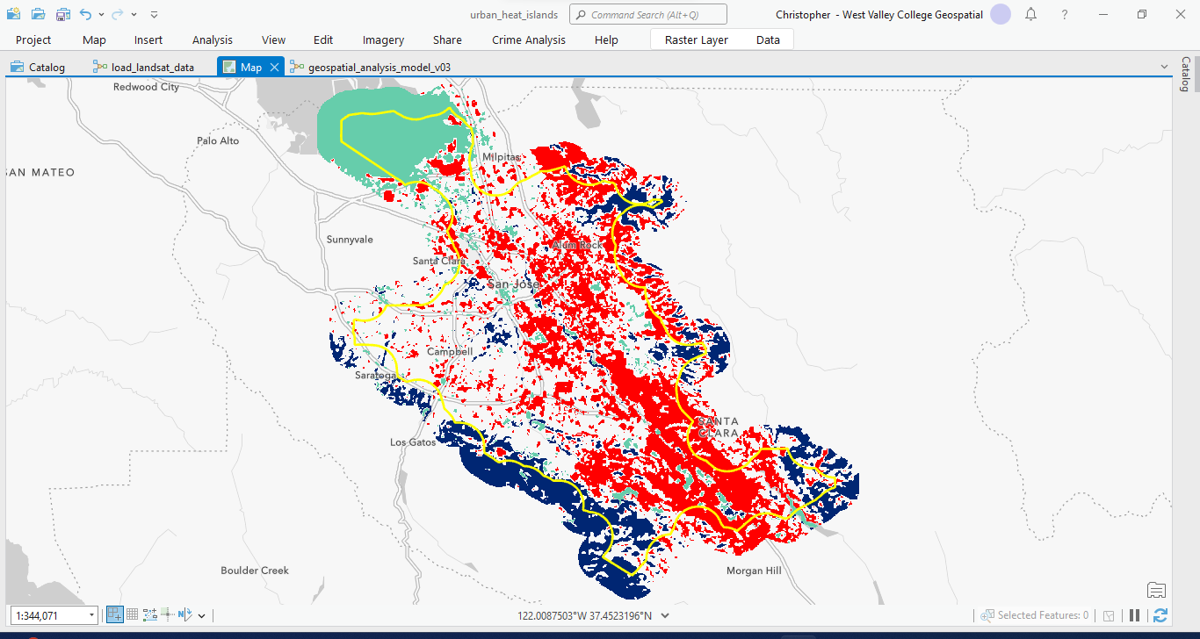
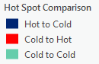
Hot Spot Comparison -- Categories

Slide 26
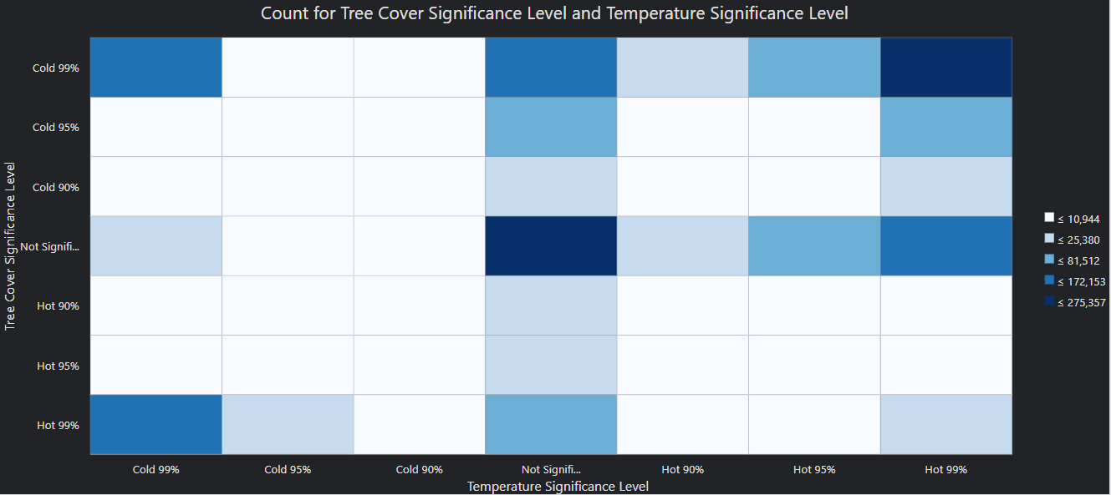
Hot Spot Comparison

Slide 27
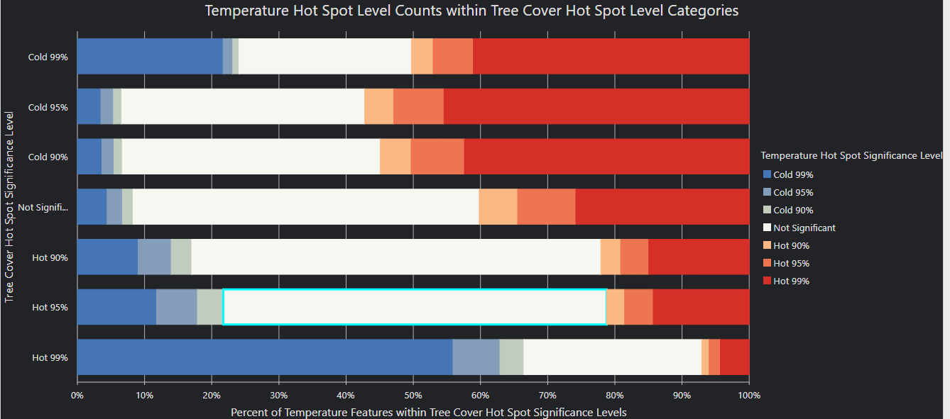
Hot Spot Comparison

Slide 28
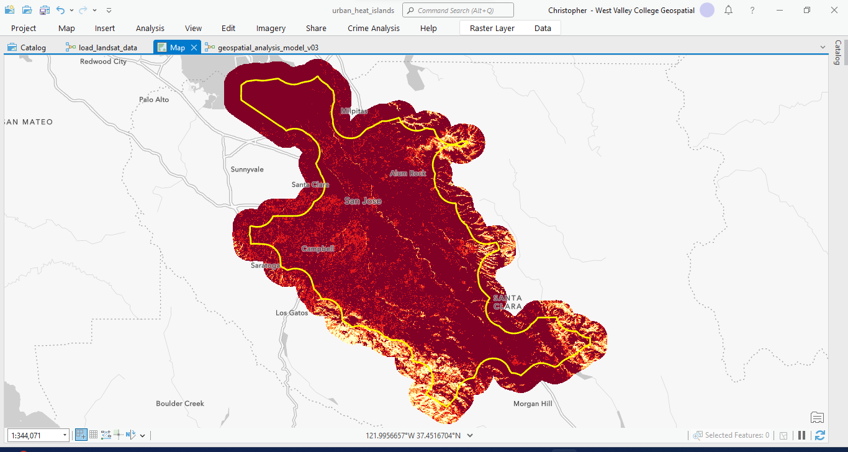
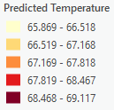
GLR -- Predicted Temperature

Slide 29
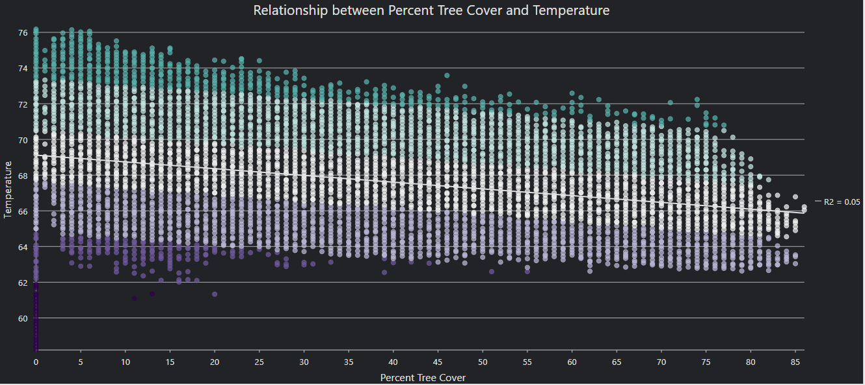
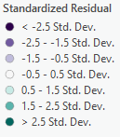
GLR -- Relationship between Variables

Slide 30
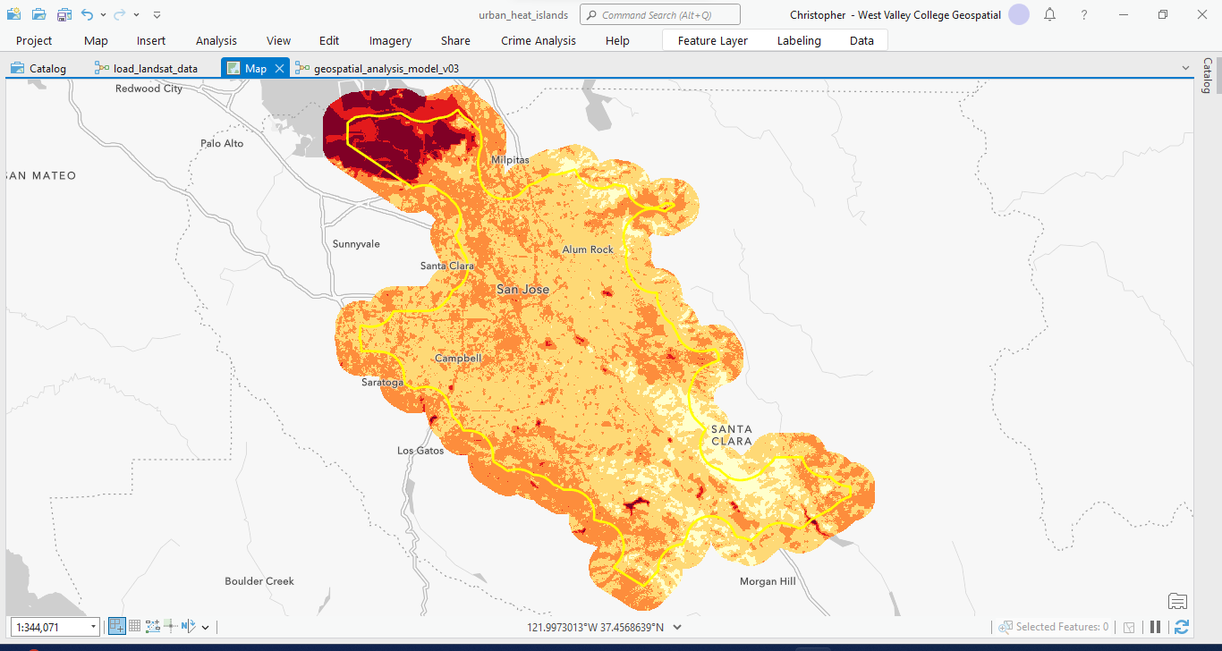
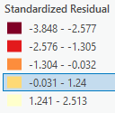
GLR -- Standardized Residuals

Slide 31
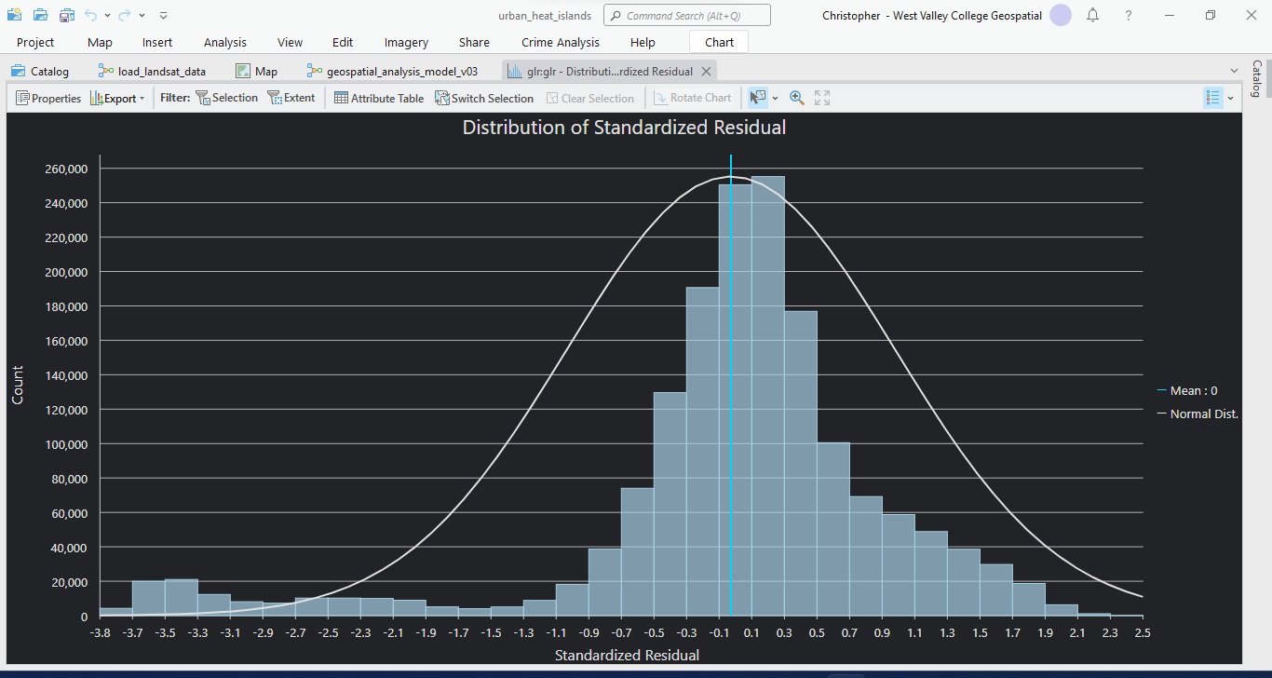
GLR -- Distribution of Standardized Residual

Slide 32
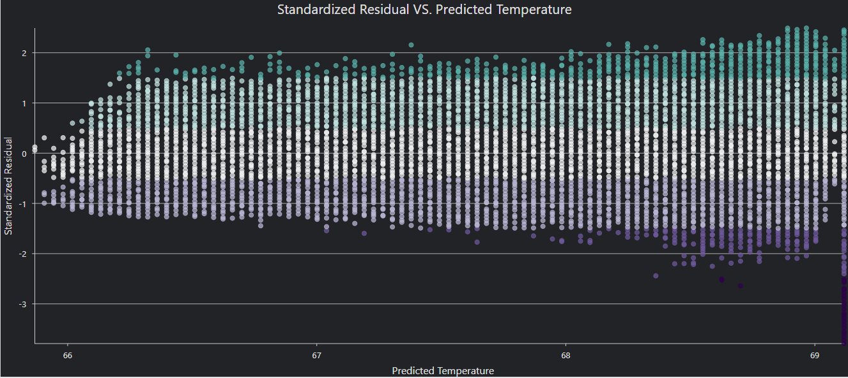
GLR -- Residual vs. Predicted Temperature

Slide 33

Decision
Analysis found:
Statistically significant clustering (spatial autocorrelation) in both tree cover and temperature input datasets
We can reject the null hypothesis that the distribution of temperature is random (p-value = 0, z-score = 1649.5)
Hot spot comparison show there is a strong relationship between tree cover and temperature (spatial fuzzy kappa = -0.0435 shows hot spots for tree cover are strongly associated with cold spots for temperature)
Ordinary least squared regression found a weak negative correlation between tree cover and temperature ($R^{2}$ value of -0.05 is not conclusive)

